Slide 1




My Algebra Interactive Notebook
$$3ab$$
$$2x+3y$$
$$\frac{5xy}{6}$$
Name :
Class :
Term 2 Semester 1
$$y=2x+1$$

Slide 2
Contents
Glossary
Page
Date
Description
2
3

Slide 3
Tasks
24
7
30
Essential Question
Questions
Notes
Summary
4
7

Slide 4
24
7
30
Date
Simplifying Expressions
EQ – How do I simplify if the terms are divided?

Slide 5

24
7
30
Date
Simplifying Expressions
EQ – How do I simplify if the terms are divided?
What happens to the $÷$ sign?

Slide 6
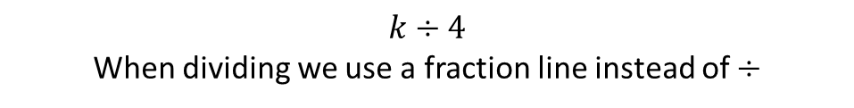
24
7
30
Date
Simplifying Expressions
EQ – How do I simplify if the terms are divided?
$$k÷4$$
When dividing we use a fraction line instead of $÷$
What happens to the $÷$ sign?

Slide 7
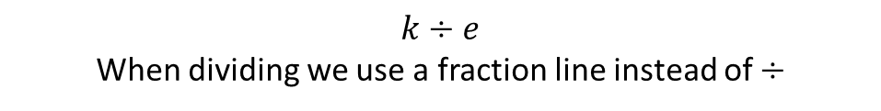
24
7
30
Date
Simplifying Expressions
EQ – How do I simplify if the terms are divided?
$$k÷e$$
When dividing we use a fraction line instead of $÷$
What happens to the $÷$ sign?
Thus: $= \frac{k}{4}$

Slide 8
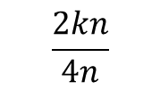
24
7
30
Date
Simplifying Expressions
EQ – How do I simplify if the terms are divided?
$$k÷e$$
When dividing we use a fraction line instead of $÷$
What happens to the $÷$ sign?
Thus: $= \frac{k}{4}$
Examples:
$$\frac{2kn}{4n}$$

Slide 9
24
7
30
Date
Simplifying Expressions
EQ – How do I simplify if the terms are divided?
$$k÷e$$
When dividing we use a fraction line instead of $÷$
What happens to the $÷$ sign?
Thus: $= \frac{k}{4}$
Examples:
Divide by 2
$$\frac{2kn}{4n}$$

Slide 10


24
7
30
Date
Simplifying Expressions
EQ – How do I simplify if the terms are divided?
$$k÷e$$
When dividing we use a fraction line instead of $÷$
What happens to the $÷$ sign?
Thus: $= \frac{k}{4}$
Examples:
Divide by 2
$$÷2$$
$$\frac{2kn}{4n}$$
$$÷2$$

Slide 11
24
7
30
Date
Simplifying Expressions
EQ – How do I simplify if the terms are divided?
$$k÷e$$
When dividing we use a fraction line instead of $÷$
What happens to the $÷$ sign?
Thus: $= \frac{k}{4}$
1
Examples:
Divide by 2
$$÷2$$
$$\frac{2kn}{4n}$$
$$÷2$$
2

Slide 12
24
7
30
Date
Simplifying Expressions
EQ – How do I simplify if the terms are divided?
$$k÷e$$
When dividing we use a fraction line instead of $÷$
What happens to the $÷$ sign?
Thus: $= \frac{k}{4}$
1
Examples:
Divide by 2
$$÷2$$
$$\frac{2kn}{4n}$$
Cancel out
$$÷2$$
2

Slide 13


24
7
30
Date
Simplifying Expressions
EQ – How do I simplify if the terms are divided?
$$k÷e$$
When dividing we use a fraction line instead of $÷$
What happens to the $÷$ sign?
Thus: $= \frac{k}{4}$
1
Examples:
$$÷2$$
$$÷n$$
Divide by 2
$$\frac{2kn}{4n}$$
Cancel out
$$÷2$$
$$÷n$$
2

Slide 14
24
7
30
Date
Simplifying Expressions
EQ – How do I simplify if the terms are divided?
$$k÷e$$
When dividing we use a fraction line instead of $÷$
What happens to the $÷$ sign?
Thus: $= \frac{k}{4}$
1
Examples:
$$÷2$$
$$÷n$$
Divide by 2
$$\frac{2kn}{4n}$$
Cancel out
$$÷2$$
$$÷n$$
2

Slide 15
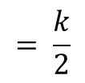
24
7
30
Date
Simplifying Expressions
EQ – How do I simplify if the terms are divided?
$$k÷e$$
When dividing we use a fraction line instead of $÷$
What happens to the $÷$ sign?
Thus: $= \frac{k}{4}$
1
Examples:
$$÷2$$
$$÷n$$
Divide by 2
$$\frac{2kn}{4n}$$
Cancel out
$$÷2$$
$$÷n$$
2
$$= \frac{k}{2}$$

Slide 16

24
7
30
Date
Simplifying Expressions
EQ – How do I simplify if the terms are divided?
$$k÷e$$
When dividing we use a fraction line instead of $÷$
What happens to the $÷$ sign?
Thus: $= \frac{k}{4}$
1
Examples:
$$÷2$$
$$÷n$$
Divide by 2
$$\frac{2kn}{4n}$$
Cancel out
$$÷2$$
$$÷n$$
2
$$= \frac{k}{2}$$
$$k means 1k$$
We don’t need to write the 1

Slide 17
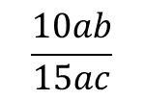
24
7
30
Date
Simplifying Expressions
EQ – How do I simplify if the terms are divided?
$$k÷e$$
When dividing we use a fraction line instead of $÷$
What happens to the $÷$ sign?
Thus: $= \frac{k}{4}$
1
Examples:
$$÷2$$
$$÷n$$
Divide by 2
$$\frac{2kn}{4n}$$
Cancel out
$$÷2$$
$$÷n$$
2
$$= \frac{k}{2}$$
$$k means 1k$$
We don’t need to write the 1
$$\frac{10ab}{15ac}$$

Slide 18


24
7
30
Date
Simplifying Expressions
EQ – How do I simplify if the terms are divided?
$$k÷e$$
When dividing we use a fraction line instead of $÷$
What happens to the $÷$ sign?
Thus: $= \frac{k}{4}$
1
Examples:
$$÷2$$
$$÷n$$
Divide by 2
$$\frac{2kn}{4n}$$
Cancel out
$$÷2$$
$$÷n$$
2
$$= \frac{k}{2}$$
$$k means 1k$$
We don’t need to write the 1
$$÷5$$
$$\frac{10ab}{15ac}$$
Divide by 5
$$÷5$$

Slide 19
24
7
30
Date
Simplifying Expressions
EQ – How do I simplify if the terms are divided?
$$k÷e$$
When dividing we use a fraction line instead of $÷$
What happens to the $÷$ sign?
Thus: $= \frac{k}{4}$
1
Examples:
$$÷2$$
$$÷n$$
Divide by 2
$$\frac{2kn}{4n}$$
Cancel out
$$÷2$$
$$÷n$$
2
$$= \frac{k}{2}$$
$$k means 1k$$
We don’t need to write the 1
2
$$÷5$$
$$\frac{10ab}{15ac}$$
Divide by 5
$$÷5$$
3

Slide 20
24
7
30
Date
Simplifying Expressions
EQ – How do I simplify if the terms are divided?
$$k÷e$$
When dividing we use a fraction line instead of $÷$
What happens to the $÷$ sign?
Thus: $= \frac{k}{4}$
1
Examples:
$$÷2$$
$$÷n$$
Divide by 2
$$\frac{2kn}{4n}$$
Cancel out
$$÷2$$
$$÷n$$
2
$$= \frac{k}{2}$$
$$k means 1k$$
We don’t need to write the 1
2
$$÷5$$
$$\frac{10ab}{15ac}$$
Cancel out
Divide by 5
$$÷5$$
3

Slide 21


24
7
30
Date
Simplifying Expressions
EQ – How do I simplify if the terms are divided?
$$k÷e$$
When dividing we use a fraction line instead of $÷$
What happens to the $÷$ sign?
Thus: $= \frac{k}{4}$
1
Examples:
$$÷2$$
$$÷n$$
Divide by 2
$$\frac{2kn}{4n}$$
Cancel out
$$÷2$$
$$÷n$$
2
$$= \frac{k}{2}$$
$$k means 1k$$
We don’t need to write the 1
2
$$÷5$$
$$\frac{10ab}{15ac}$$
$$÷a$$
Cancel out
Divide by 5
$$÷5$$
$$÷a$$
3

Slide 22
24
7
30
Date
Simplifying Expressions
EQ – How do I simplify if the terms are divided?
$$k÷e$$
When dividing we use a fraction line instead of $÷$
What happens to the $÷$ sign?
Thus: $= \frac{k}{4}$
1
Examples:
$$÷2$$
$$÷n$$
Divide by 2
$$\frac{2kn}{4n}$$
Cancel out
$$÷2$$
$$÷n$$
2
$$= \frac{k}{2}$$
$$k means 1k$$
We don’t need to write the 1
2
$$÷5$$
$$\frac{10ab}{15ac}$$
$$÷a$$
Cancel out
Divide by 5
$$÷5$$
$$÷a$$
3

Slide 23
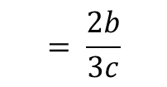
24
7
30
Date
Simplifying Expressions
EQ – How do I simplify if the terms are divided?
$$k÷e$$
When dividing we use a fraction line instead of $÷$
What happens to the $÷$ sign?
Thus: $= \frac{k}{4}$
1
Examples:
$$÷2$$
$$÷n$$
Divide by 2
$$\frac{2kn}{4n}$$
Cancel out
$$÷2$$
$$÷n$$
2
$$= \frac{k}{2}$$
$$k means 1k$$
We don’t need to write the 1
2
$$÷5$$
$$\frac{10ab}{15ac}$$
$$÷a$$
Cancel out
Divide by 5
$$÷5$$
$$÷a$$
3
$$= \frac{2b}{3c}$$

Slide 24
Let’s try these together
$$\frac{18x^{2}y}{8xz}$$

Slide 25
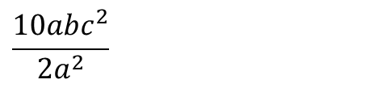
Let’s try these together
$$\frac{18x^{2}y}{8xz}$$
$$\frac{10abc^{2}}{2a^{2}}$$

Slide 26
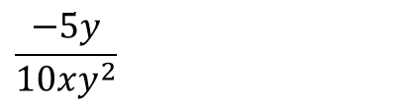
Let’s try these together
$$\frac{18x^{2}y}{8xz}$$
$$\frac{10abc^{2}}{2a^{2}}$$
$$\frac{−5y}{10xy^{2}}$$

Slide 27
Task
Enrichment:

Slide 28
Answers

Slide 29
Notes Review
24, 7 ,30
Date
Title
Essential question
Notes complete
Notes complete with colour and diagrams
Questions completed
Contents page filled in
Formula page filled in

Slide 30
Homework
Review your notes and write a summary answering the essential question.

